Slide 1
WEEK 4
Feature Engineering I
Turning cleaned data into effective model inputs
Day 16
Encoding
Label encoding, one-hot, high-cardinality strategies
Day 17
Scaling
Min-Max, standardization, robust scaling, leakage
Day 18
Binning & Discretization
Equal-width, equal-frequency, domain-driven
Day 19
Transformation Methods
Log, sqrt, Box-Cox, Yeo-Johnson
Day 20
Integrated Exercise
Full pipeline, interactions, evaluation, bias
BASE DATASET
df = pd.DataFrame({"city": ["NY", "SF", "LA"], "membership": ["bronze", "silver", "gold"],
"purchases": [3, 5, 1]})
# Encoding choices strongly affect model performance, interpretability, and bias

Slide 2
DAY 16
Encoding Categorical Features
Label Encoding, One-Hot, and High-Cardinality Strategies
OBJECTIVES
ACTIVITY
• Distinguish nominal vs ordinal categories
• Implement label and one-hot encoding
• Understand the dummy variable trap
• Handle high-cardinality categories
• Analyze encoding impact on model families
Apply one-hot encoding to a categorical feature.
Compare model behavior before and after encoding.
ASSESSMENT
Scenario-based questions: choose encoding strategies and justify decisions.
Week 4 · Feature Engineering I

Slide 3
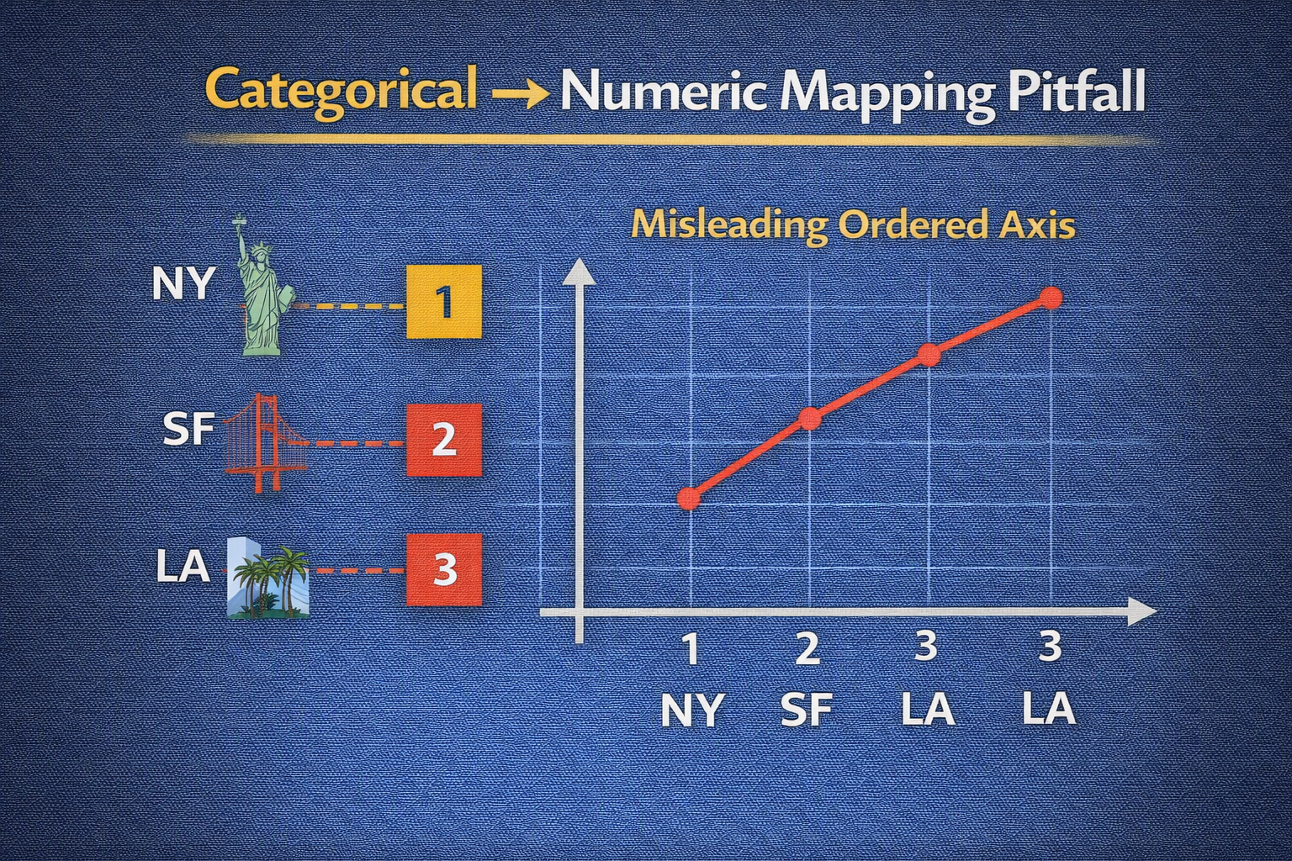
DAY 16 · ENCODING
Why Categorical Data Cannot Be Used Directly
Raw categories have no inherent numerical magnitude
Key Problems
Risks of Naive Mapping
• Most ML libraries require numeric float inputs
• Implicit ordering from arbitrary integers (NY→1, SF→2) misleads linear models
• Distance metrics don't know 'NY' and 'SF' are just different labels
• Linear models: LA (3) appears 'between' SF (2) and CHI (4)
• Differences seem meaningful: CHI - NY = 3
• Trees still split on ordered thresholds
NAIVE MAPPING - RISKY
city_map_naive = {"NY": 1, "SF": 2, "LA": 3, "CHI": 4}
df16["city_naive_int"] = df16["city"].map(city_map_naive)
# For a linear model: implies LA is "between" SF and CHI - wrong!

Slide 4
DAY 16 · ENCODING
Nominal vs Ordinal Categories
Why the distinction matters for encoding
Nominal Categories
Ordinal Categories
Categories with NO inherent order
Examples: city, color, product type
Any numeric ordering is artificial and can mislead models
Categories with meaningful order but not equal spacing
Examples: bronze < silver < gold
Preserving order helps capture monotonic relationships
CREATING ORDINAL CODE FOR MEMBERSHIP LEVEL
membership_order = pd.CategoricalDtype(
categories=["bronze", "silver", "gold"], ordered=True)
df16["membership_ord"] = df16["membership_level"].astype(membership_order).cat.codes
# Now bronze=0, silver=1, gold=2 - reflecting meaningful order

Slide 5
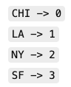
DAY 16 · ENCODING
Label Encoding — Definition, Uses, and Risks
Maps each category to an integer
When Label Encoding Is Acceptable
When Label Encoding Is Risky
• Ordinal categories where order is meaningful
• Tree-based models on nominal categories (splits still separate groups)
• Memory-efficient single column
• Linear or distance-based models on nominal variables
• Imposes false order and distance
• KNN/K-Means heavily affected
LABEL ENCODING WITH sklearn
from sklearn.preprocessing import LabelEncoder
le_city = LabelEncoder()
df16["city_label"] = le_city.fit_transform(df16["city"])
print("Classes:", le_city.classes_) # Sorted alphabetically: CHI, LA, NY, SF

Slide 6
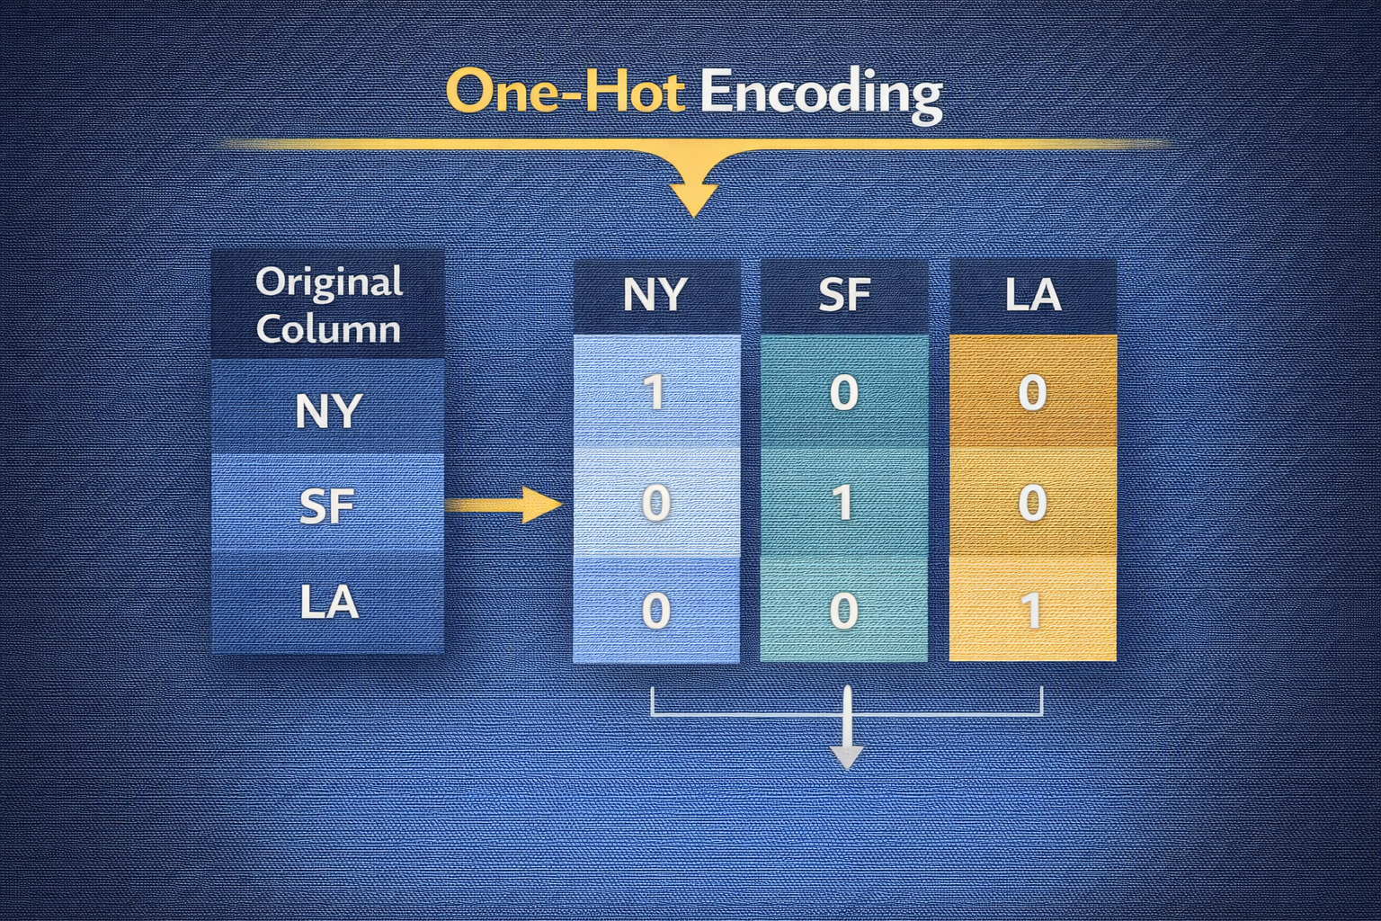
DAY 16 · ENCODING
One-Hot Encoding with pandas
Binary indicator column for each category
How It Changes Feature Space
ML Interpretation
• Replaces one column with k binary columns
• Each row has 1 in exactly one column, 0 in others
• Avoids artificial ordering
• Linear models: separate coefficient per category
• Trees: can split on each dummy independently
• Distance-based: sees binary coordinates (more sparse)
ONE-HOT WITH pd.get_dummies
df16_ohe = pd.get_dummies(df16, columns=["city"], prefix="city")
print(df16_ohe.head())
# Creates: city_CHI, city_LA, city_NY, city_SF columns

Slide 7
DAY 16 · ENCODING
One-Hot Encoding with sklearn OneHotEncoder
Pipeline-ready with sparse matrix output
Benefits
Integration
• Fit once on training, apply same mapping to test
• Handles unseen categories with configurable behavior
• Sparse output is memory-efficient
• Works with ColumnTransformer for mixed pipelines
• Sparse output passes directly into ML estimators
• For inspection, convert to dense (avoid on large data)
OneHotEncoder USAGE
from sklearn.preprocessing import OneHotEncoder
ohe = OneHotEncoder(sparse=True, handle_unknown="ignore")
city_encoded = ohe.fit_transform(df16[["city"]])
print("Encoded shape:", city_encoded.shape, "Categories:", ohe.categories_)

Slide 8
DAY 16 · ENCODING
Dummy Variable Trap and Redundant Columns
Perfect multicollinearity in linear models
The Problem
Solution
Sum of all dummy columns equals 1
Including all dummies + intercept creates perfect multicollinearity
OLS estimates become non-unique, stability suffers
Drop one dummy column - becomes reference group
Coefficients interpreted relative to dropped category
Trees are robust to redundancy but dropping reduces dimensionality
DROP ONE DUMMY TO AVOID REDUNDANCY
df16_ohe_drop = pd.get_dummies(df16, columns=["city"], prefix="city", drop_first=True)
print(df16_ohe_drop.head()) # CHI becomes reference (dropped), only LA, NY, SF remain

Slide 9
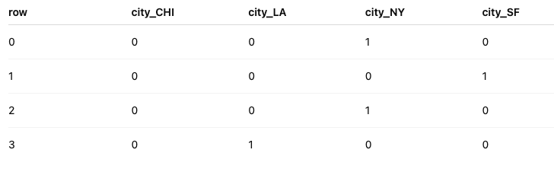
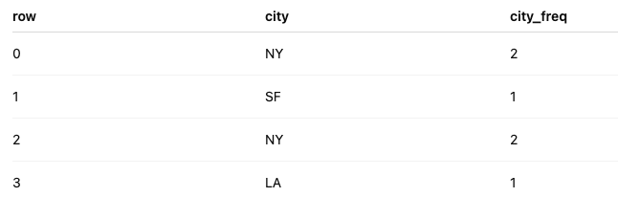
DAY 16 · ENCODING
High-Cardinality Categorical Variables
Thousands of categories cause memory and overfitting issues
Challenges
Strategies
• Huge one-hot matrices → memory issues, overfitting
• Sparse signals per category → unreliable coefficients
• Basic one-hot treats each category independently
• Frequency encoding: replace category with its count
• Target encoding: mean target per category (leakage risk!)
• Group rare categories into 'other' or domain-based groups
FREQUENCY ENCODING
city_counts = df16["city"].value_counts()
df16["city_freq"] = df16["city"].map(city_counts)
# Preserves common vs rare info without dimension explosion

Slide 10
DAY 16 · ENCODING
Encoding Impact on Different Model Families
Choose encoding based on model type
Linear Models
Tree-Based
Distance-Based
• One-hot: separate coefficients
• Label on nominal: harmful
✓ Use one-hot
• Can work with label encoding
• One-hot may or may not help
✓ Either approach works
• KNN, K-Means, SVM RBF
• Arbitrary integers distort
✓ One-hot or binary
QUICK COMPARISON: NAIVE VS ONE-HOT
from sklearn.linear_model import LinearRegression
X_naive = df16[["city_naive_int"]]; X_ohe = pd.get_dummies(df16[["city"]], drop_first=True)
lm_naive = LinearRegression().fit(X_naive, y); lm_ohe = LinearRegression().fit(X_ohe, y)
print("R² naive:", lm_naive.score(X_naive, y), "R² one-hot:", lm_ohe.score(X_ohe, y))

Slide 11
DAY 16 · ENCODING
Encoding exercise
Choose encoding based on model type
1 - Load the dataset
2 - Label encode the city column
3 - Apply one-hot encoding on the city column on a copy dataset
4 - Print the result and compare between the two methods
LABEL ENCODING WITH sklearn
from sklearn.preprocessing import LabelEncoder
le_city = LabelEncoder()
df16["city_label"] = le_city.fit_transform(df16["city"])
print("Classes:", le_city.classes_) # Sorted alphabetically: CHI, LA, NY, SF

Slide 12
DAY 17
Scaling Numerical Features
Min-Max, Standardization, and Robust Scaling
OBJECTIVES
ACTIVITY
• Explain why scaling matters for distance/gradient algorithms
• Implement Min-Max, standard, and robust scaling
• Visualize distributions before and after
• Apply scaling without leaking information
• Understand scaling impact per algorithm family
Scale two numerical features and compare distributions visually.
ASSESSMENT
Justify when Min-Max preferred over standardization and vice versa.
Week 4 · Feature Engineering I

Slide 13
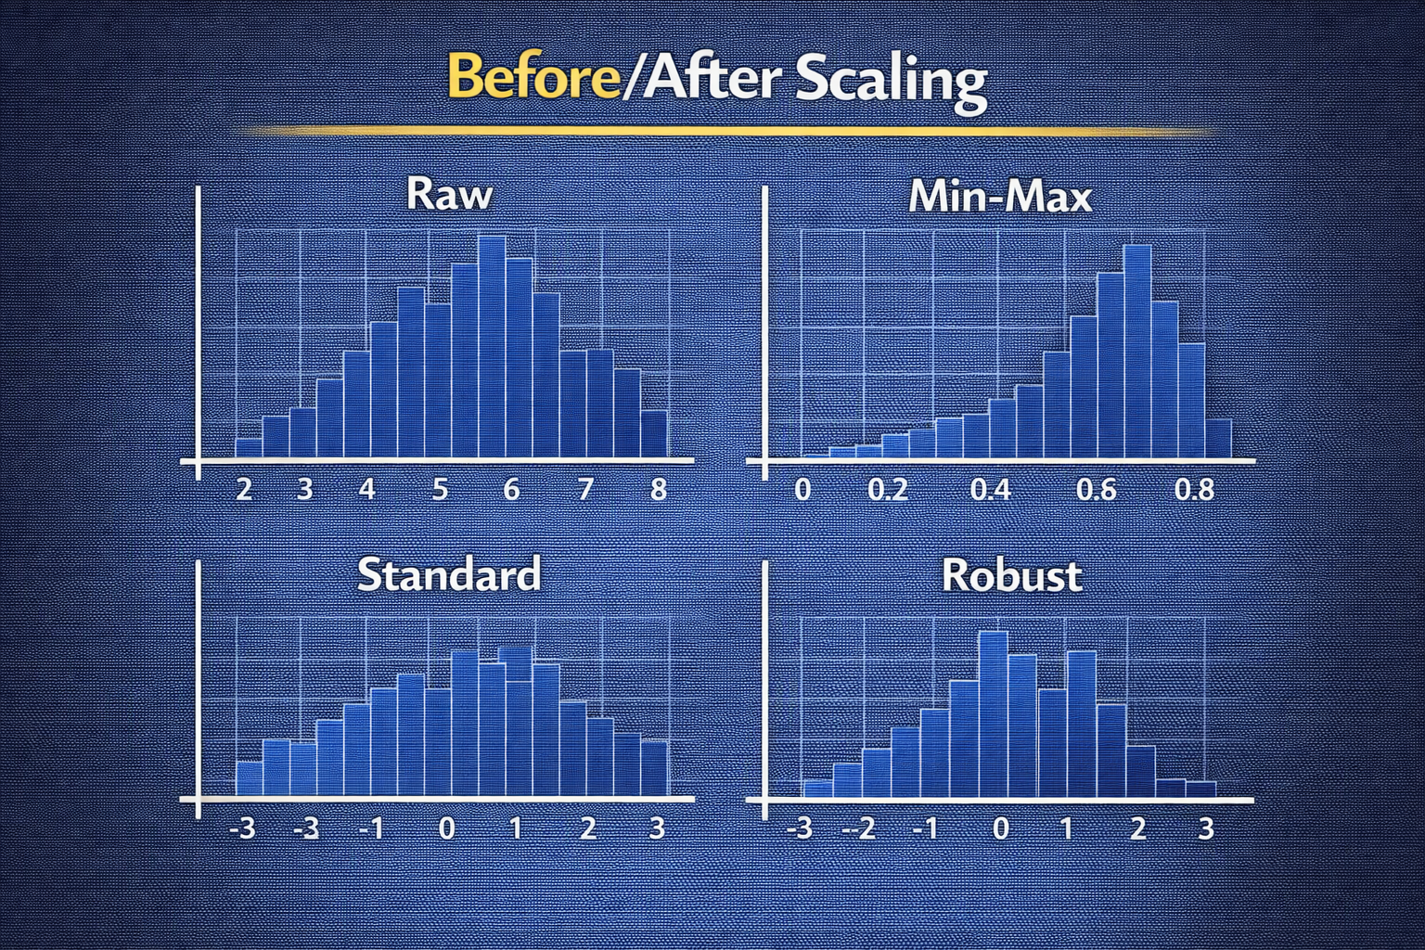
DAY 17 · SCALING
Why Scaling Is Necessary for Many Algorithms
Unscaled features with different ranges distort models
Distortions Without Scaling
Example
• Distance calculations (KNN, K-Means): larger-range features dominate
• Gradient descent (linear, neural nets): uneven steps
• SVM with RBF kernel: margin calculations affected
• CRIM ranges 0–80
• RM (rooms) ranges 3–9
Unscaled: KNN chooses neighbors primarily based on CRIM simply due to larger numeric range
RANGE INSPECTION
print(df17[["CRIM", "RM"]].agg(["min", "max"]))
# If plugged directly into KNN, CRIM dominates distance calculations

Slide 14
DAY 17 · SCALING
Min-Max Scaling — Definition and Implementation
Rescales to fixed range [0, 1]
Formula
Use Cases
x_scaled = (x - x_min) / (x_max - x_min)
• Preserves relative ordering (monotonic)
• Compresses all values into [0, 1]
• Algorithms that rely on distances or bounded input
• Retain distribution shape but normalize range
Caveat: Outliers compress bulk of data toward 0
MinMaxScaler
from sklearn.preprocessing import MinMaxScaler
mm_scaler = MinMaxScaler()
df17_mm = df17.copy()
df17_mm[["CRIM_mm", "RM_mm"]] = mm_scaler.fit_transform(df17[["CRIM", "RM"]])
# Both now in [0, 1]

Slide 15
DAY 17 · SCALING
Standardization (Z-Score Scaling)
Mean ≈ 0, standard deviation ≈ 1
Formula
Effects
z = (x - μ) / σ
• Centers data and scales variance to one
• Useful for regularized models, PCA
• Ensures penalties treat features comparably in Lasso/Ridge
• Does NOT remove skewness - only rescales
• Sensitive to outliers in mean/std calculation
StandardScaler
from sklearn.preprocessing import StandardScaler
std_scaler = StandardScaler()
df17_std = df17.copy()
df17_std[["CRIM_std", "RM_std"]] = std_scaler.fit_transform(df17[["CRIM", "RM"]])
print(df17_std[["CRIM_std", "RM_std"]].agg(["mean", "std"])) # mean≈0, std≈1

Slide 16
DAY 17 · SCALING
Robust Scaling — Handling Outliers Gracefully
Uses median and IQR instead of mean and std
Formula
Use Cases
x_robust = (x - median) / IQR
Reduces sensitivity to outliers
• Features with heavy tails or clear outliers
• Want scaling without outliers dominating
• Does NOT cap outliers, just reduces influence
RobustScaler
from sklearn.preprocessing import RobustScaler
rob_scaler = RobustScaler()
df17_rob = df17.copy()
df17_rob[["CRIM_rob", "RM_rob"]] = rob_scaler.fit_transform(df17[["CRIM", "RM"]])

Slide 17
DAY 17 · SCALING
Scaling and Data Leakage — Safe Workflows
Fit scaler on training data only
Safe Workflow
Leakage Effects
1. Split data into train and test
2. Fit scaler on train only
3. Apply fitted scaler to both train and test
Never call fit on combined train+test!
Using full dataset leaks future information into training
• Over-optimistic metrics
• Degraded production performance
LEAKAGE-SAFE SCALING
X_train, X_test, y_train, y_test = train_test_split(X, y, test_size=0.2, random_state=17)
scaler = StandardScaler()
X_train_scaled = scaler.fit_transform(X_train) # Fit on train
X_test_scaled = scaler.transform(X_test) # Only transform test

Slide 18
DAY 17 · SCALING
Scaling Impact on Different Algorithms
Essential for some, irrelevant for others
Essential
Recommended
Usually Not Needed
• KNN / K-Means: distance sensitive
• SVM with RBF kernel
• Neural networks
• Linear/logistic regression: helps convergence
• Regularized models: comparable penalties
• Decision trees
• Random forests
• Gradient boosting
KNN WITH AND WITHOUT SCALING
from sklearn.neighbors import KNeighborsRegressor
knn_raw = KNeighborsRegressor(n_neighbors=5).fit(X_train, y_train)
knn_scaled = KNeighborsRegressor(n_neighbors=5).fit(X_train_scaled, y_train)
print("MSE raw:", mse(y_test, knn_raw.predict(X_test)))
print("MSE scaled:", mse(y_test, knn_scaled.predict(X_test_scaled))) # Usually lower

Slide 19
DAY 18
Binning & Discretization
Converting Continuous Features to Categories
OBJECTIVES
ACTIVITY
• Explain why and when discretization helps
• Implement equal-width and equal-frequency binning
• Design domain-driven bins (e.g., age groups)
• Assess interpretability vs information loss
• Compare binned vs continuous in models
Bin an Age column into Child, Teen, Adult, Senior categories.
ASSESSMENT
Submit code and explanation for chosen bin thresholds.
Week 4 · Feature Engineering I

Slide 20
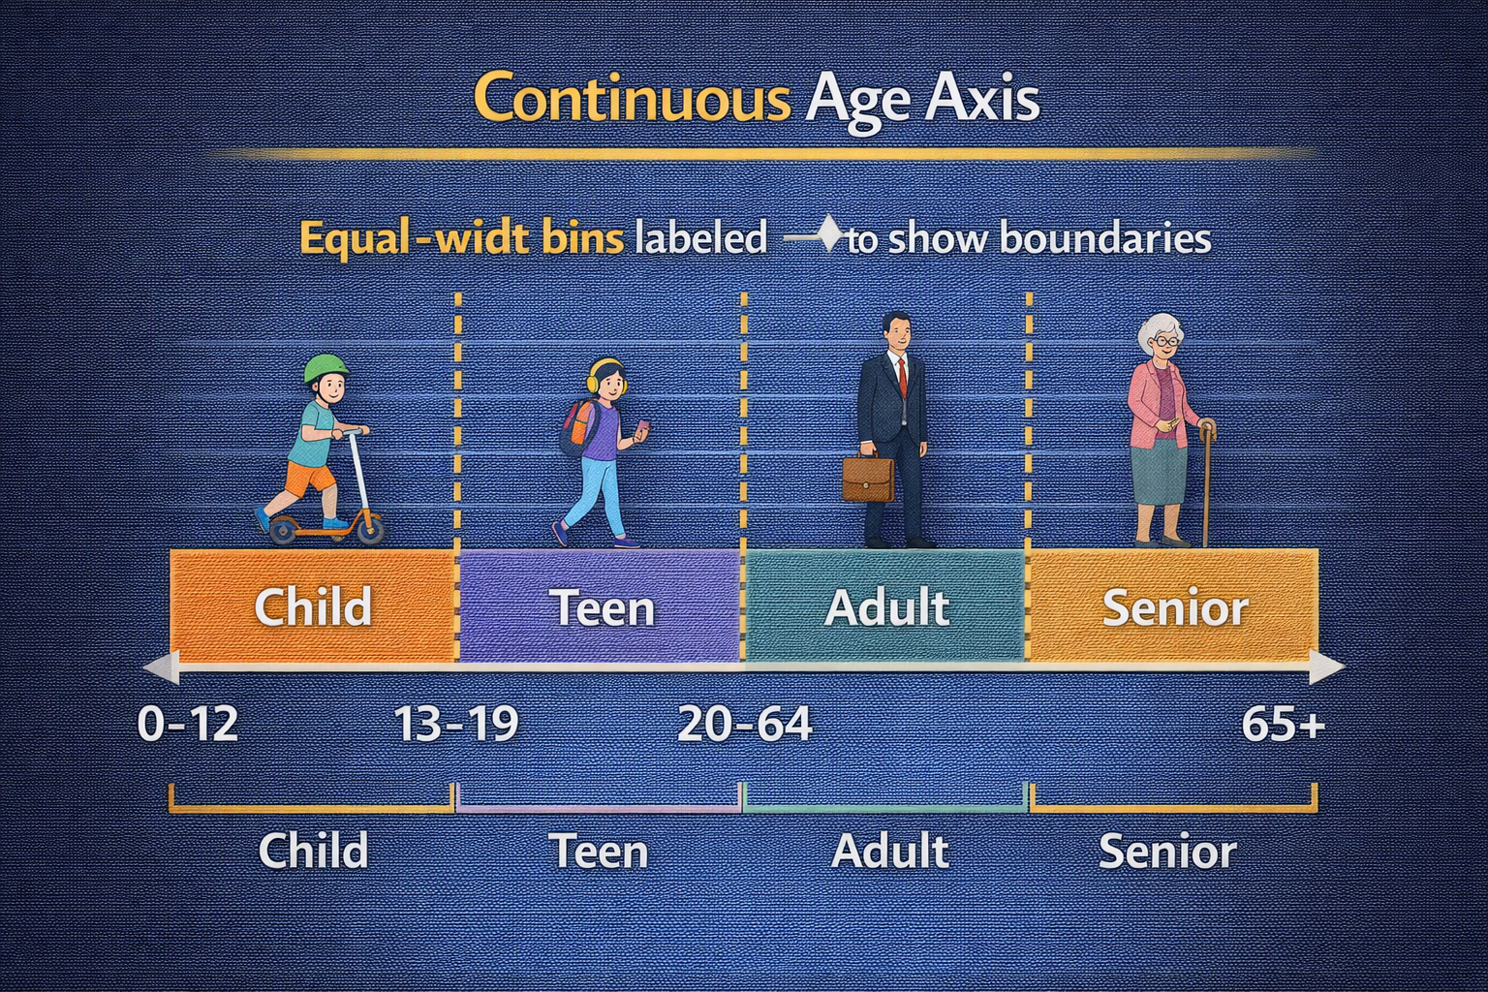
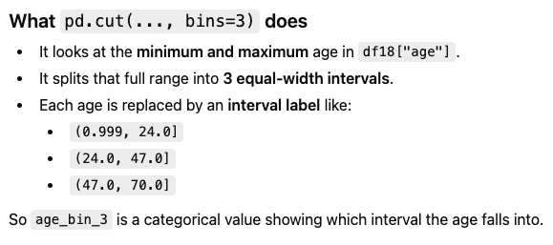
DAY 18 · BINNING
Why Discretization Can Help Models
Replace raw values with bin indicators
Benefits
Risks
• Noise reduction: small variations within bin treated as equivalent
• Non-linear effects: bins capture step changes (age 18, 21, 65)
• Interpretability: bins are human-readable
• Information loss: differences within bin ignored
• Arbitrary boundaries can introduce artifacts
• May hurt tree models that already find optimal splits
SIMPLE EQUAL-WIDTH BINS
df18["age_bin_3"] = pd.cut(df18["age"], bins=3)
print(df18[["age", "age_bin_3"]].head())
# pd.cut chooses boundaries based on min/max - may not align with meaningful ages

Slide 21
DAY 18 · BINNING
Equal-Width Binning with pd.cut
Divides range into intervals of equal size
How It Works
Custom Edges
• Split [min, max] into N equal-sized intervals
• Simple but may create unbalanced bins if distribution skewed
Specify domain-informed edges instead of purely equal-width
Example: [0, 18, 35, 50, 100] for age ranges
EQUAL-WIDTH WITH CUSTOM EDGES
bin_edges = [0, 18, 35, 50, 100]
labels = ["Child", "YoungAdult", "Adult", "Senior"]
df18["age_bins_width"] = pd.cut(df18["age"], bins=bin_edges, labels=labels, right=False)
print(df18["age_bins_width"].value_counts())

Slide 22
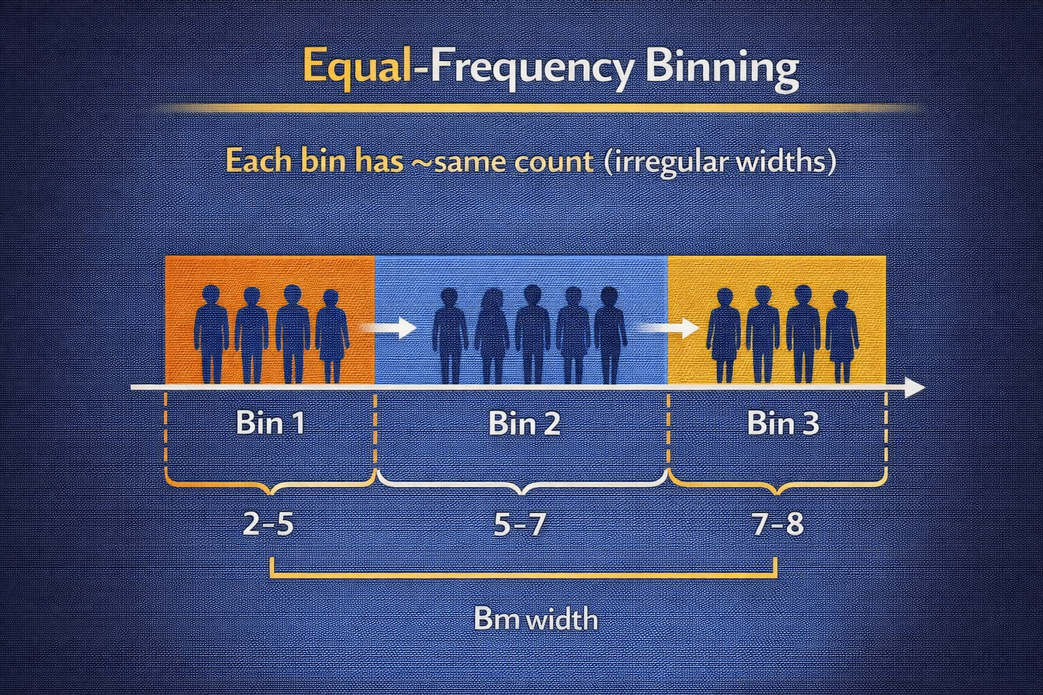
DAY 18 · BINNING
Equal-Frequency Binning with pd.qcut
Roughly same number of observations per bin
How It Works
Benefits
• Quantile-based: each bin gets ~same count
• Stabilizes estimates but produces irregular bin widths
• Boundaries may not align with meaningful values
• Each bin has similar statistical power
• Good for modeling and stability
• Works well when equal-width would create sparse bins
QUARTILE-BASED BINS
df18["age_bins_quantiles"] = pd.qcut(df18["age"], q=4, labels=["Q1", "Q2", "Q3", "Q4"])
print(df18["age_bins_quantiles"].value_counts()) # ~Equal counts per bin

Slide 23
DAY 18 · BINNING
Domain-Driven Binning — Age Groups Example
Meaningful bins aligned with policy or behavior
Domain Knowledge
Best Practice
• Children, teens, adults, seniors align with many business/policy thresholds
• Legal ages vary by region (13, 18, 21, 65...)
• Interpretable to stakeholders
• Document bin boundaries and rationale
• Ensure ranges reflect domain-specific rules
• Easy to explain in reports and audits
AGE BINS: CHILD, TEEN, ADULT, SENIOR
age_edges = [0, 13, 18, 65, 120]
age_labels = ["Child", "Teen", "Adult", "Senior"]
df18["age_group"] = pd.cut(df18["age"], bins=age_edges, labels=age_labels, right=False)
print(df18["age_group"].value_counts())

Slide 24
DAY 19
Transformation Methods
Log, Sqrt, Box-Cox, and Yeo-Johnson
OBJECTIVES
ACTIVITY
• Recognize skewed distributions and why they're problematic
• Apply np.log1p and np.sqrt to reduce skew
• Use PowerTransformer for Box-Cox/Yeo-Johnson
• Compare before/after distributions visually
• Understand impact on linear model assumptions
Apply log transformation to skewed feature and visualize before/after.
ASSESSMENT
Explain how transformations interact with linearity assumptions.
Week 4 · Feature Engineering I

Slide 25
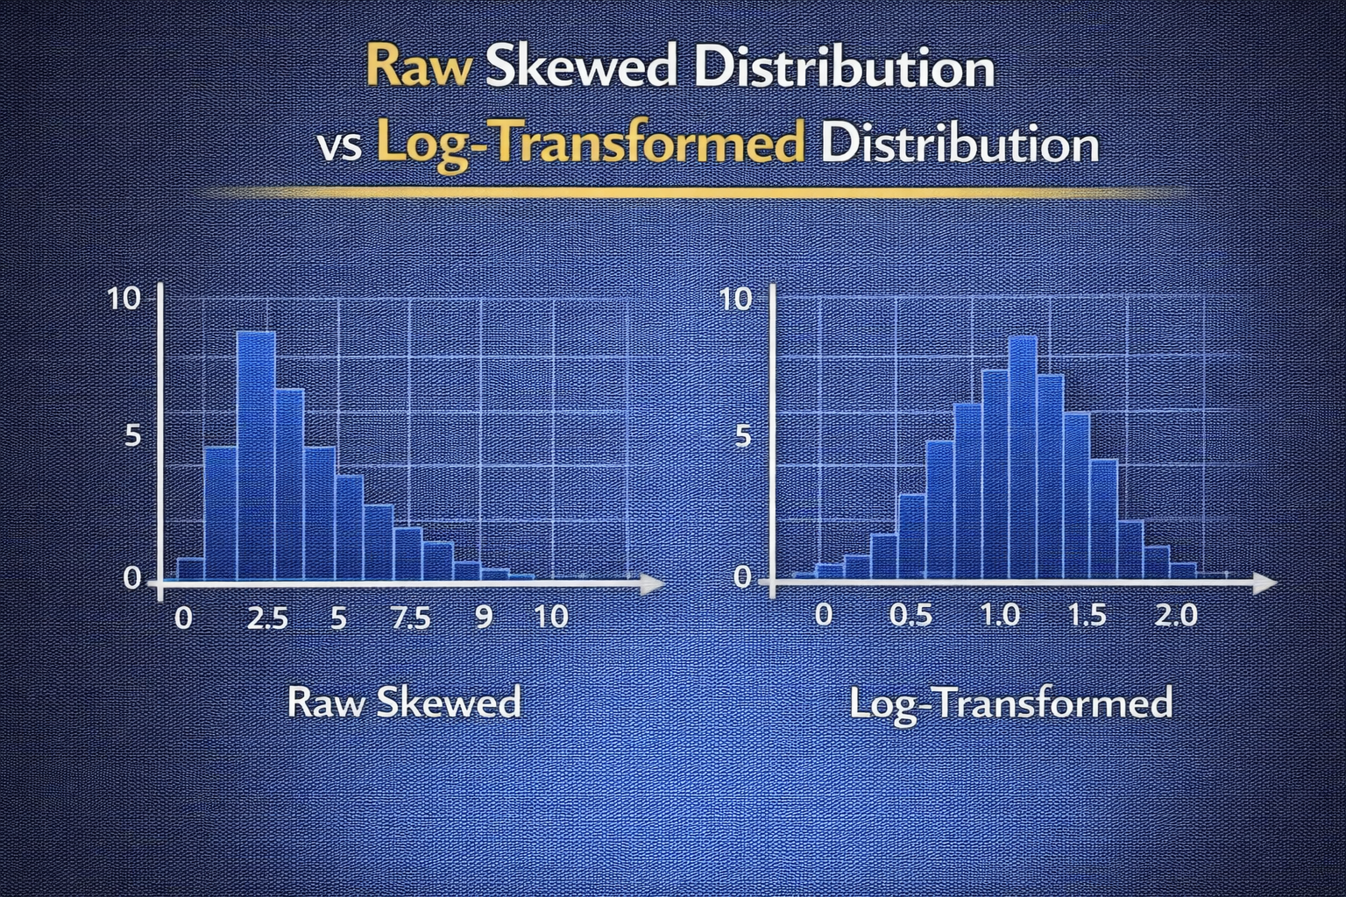
DAY 19 · TRANSFORMATIONS
Skewed Distributions and Why They Matter
Long tails affect model behavior
Why Skew Is Problematic
Common Skewed Features
• Linear regression: outliers exert large influence on coefficients
• Gaussian-based models assume/prefer approximate normality
• Visualization and interpretation harder with extreme skew
• Income, spend, transaction amounts
• Time-on-site, page views, clicks
• Positive values with long right tail
MEASURING SKEWNESS
print(df19["spend"].describe()) # Note large max vs median
sns.histplot(df19["spend"], kde=True)
plt.title("Spend distribution (raw)") # Long right tail

Slide 26
DAY 19 · TRANSFORMATIONS
Log Transform with np.log1p
Compress large values, spread small values
Properties
Use Cases
• log1p(x) = log(1 + x) — safe for zeros
• Compresses large values
• Spreads small values
• Makes relative differences more linear
• Positive-valued features with long right tails
• Income, time-on-site, click counts
• When relative differences matter more than absolute
LOG-TRANSFORMING SPEND
df19["spend_log1p"] = np.log1p(df19["spend"])
fig, axes = plt.subplots(1, 2, figsize=(10, 4))
sns.histplot(df19["spend"], ax=axes[0]); axes[0].set_title("Spend raw")
sns.histplot(df19["spend_log1p"], ax=axes[1]); axes[1].set_title("Spend log1p") # More symmetric

Slide 27
DAY 19 · TRANSFORMATIONS
Square-Root Transformation
Less aggressive than log for count-like data
Properties
Use Cases
• sqrt(x) reduces skew less than log
• Keeps stronger distinction between medium and high values
• Works well for counts with zeros
• Count features: events, clicks, logins
• When you want to reduce skew moderately
• More interpretable than log for some stakeholders
SQRT TRANSFORMATION OF TRANSACTIONS
df19["transactions_sqrt"] = np.sqrt(df19["transactions"])
fig, axes = plt.subplots(1, 2, figsize=(10, 4))
sns.histplot(df19["transactions"], ax=axes[0], discrete=True); axes[0].set_title("Transactions raw")
sns.histplot(df19["transactions_sqrt"], ax=axes[1]); axes[1].set_title("Transactions sqrt")

Slide 28
DAY 19 · TRANSFORMATIONS
Transformation Impact on Linear Models
Better fit in transformed space
Without Transformation
With Transformation
• Model fits linear relationship in raw space
• Skew and heavy tails distort coefficients
• Poor fit, unstable predictions
• Model sees more linear relationship
• Better fit, more stable coefficients
• Usually higher R² on transformed features
LINEAR REGRESSION COMPARISON
X_raw = df19[["spend"]]; X_log = df19[["spend_log1p"]]
lm_raw = LinearRegression().fit(X_raw, y)
lm_log = LinearRegression().fit(X_log, y)
print("R² raw:", lm_raw.score(X_raw, y), "R² log:", lm_log.score(X_log, y))

Slide 29
DAY 19 · TRANSFORMATIONS
When NOT to Transform
Interpretability and business logic considerations
Interpretation Challenges
When to Avoid
• Log-transformed coefficient is in log units, not dollars
• Stakeholders may prefer models in original scale
• Back-transformation can be confusing
• Simple descriptive models where interpretability matters
• Business rules use raw thresholds (credit limits)
• Can keep both raw and transformed, let regularization decide
KEEPING BOTH RAW AND TRANSFORMED
df19["spend_both"] = df19["spend"] # Raw
# Already have spend_log1p
# Be careful: avoid multicollinearity issues

Slide 30
DAY 20
Integrated Feature Engineering
Combining All Techniques into a Pipeline
OBJECTIVES
ACTIVITY
• Combine encoding, scaling, binning, transformations
• Explore feature interactions
• Evaluate engineered features properly
• Identify and avoid feature leakage
• Reflect on bias introduced through feature choices
Build full feature pipeline with baseline vs enhanced comparison.
ASSESSMENT
Written reflection on feature impact and bias considerations.
Week 4 · Feature Engineering I

Slide 31
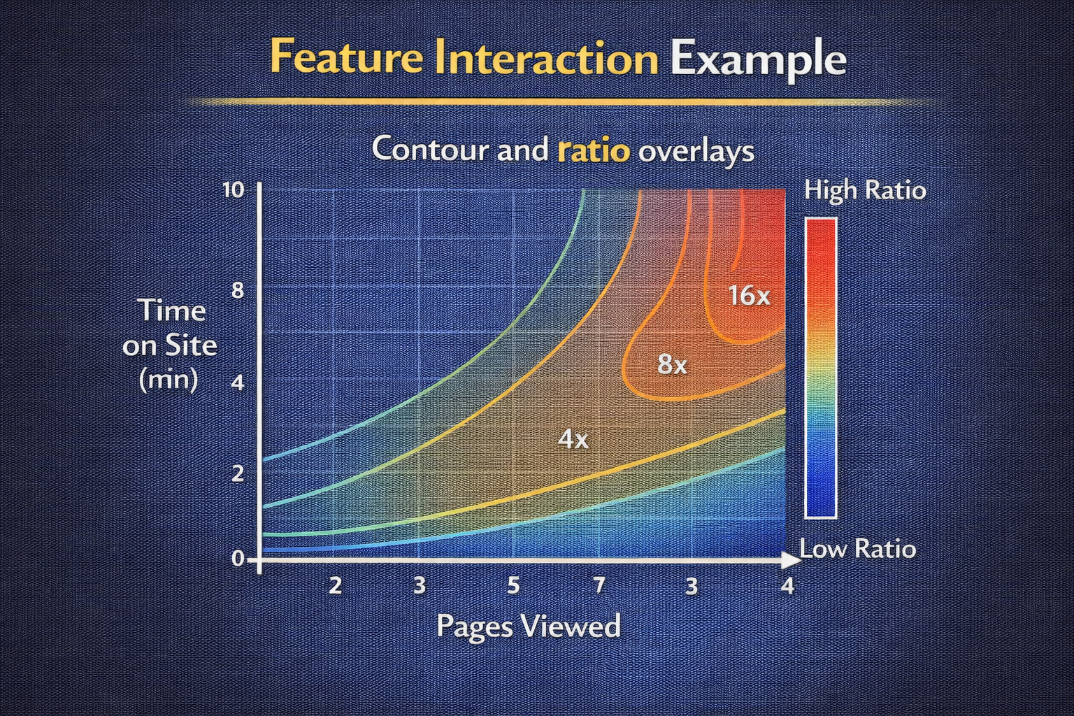
DAY 20 · INTEGRATED EXERCISE
Feature Interactions — Why Combine Features?
Individual features may not capture relevant patterns
Intuition
Risks
• pages_viewed and time_on_site individually useful
• Their ratio pages_per_minute captures engagement intensity
• Interactions approximate non-linear relationships for linear models
• Feature explosion: too many interactions → overfit
• Harder interpretability
• Document which interactions and why
SIMPLE INTERACTION FEATURES
df20["pages_per_min"] = df20["pages_viewed"] / (df20["session_minutes"] + 1e-3)
df20["is_mobile_high_spend"] = (
(df20["device_type"] == "mobile") & (df20["basket_value"] > df20["basket_value"].median())
).astype(int) # Mix numeric and categorical

Slide 32
DAY 20 · INTEGRATED EXERCISE
Evaluating Engineered Features — Beyond Accuracy
Check predictive power, stability, and fairness
What to Check
Compare Baseline vs Enhanced
• Predictive performance (accuracy, AUC, RMSE)
• Calibration of probabilities
• Stability across cross-validation folds
• Fairness across subgroups
• Train model with raw features only
• Train model with engineered features
• Measure improvement and interpret
COMPARING MODELS WITH RAW VS ENGINEERED
base_features = ["pages_viewed", "session_minutes", "basket_value"]
engineered_features = base_features + ["pages_per_min", "is_mobile_high_spend"]
clf = LogisticRegression(max_iter=1000).fit(X_train[engineered_features], y_train)
print("AUC with engineered:", roc_auc_score(y_test, clf.predict_proba(X_test)[:, 1]))

Slide 33
DAY 20 · INTEGRATED EXERCISE
Avoiding Feature Leakage in Engineering
Don't use information unavailable at prediction time
Leakage Examples
Prevention
• Using post-outcome events (total purchases after signup to predict churn)
• Target encoding on full data including test
• Scaling with mean/std from combined train+test
• Fit all transformers on training data only
• Use out-of-fold strategies for target encoding
• Think: would this feature be available at prediction time?
UNSAFE VS SAFE TARGET ENCODING (ILLUSTRATIVE)
# UNSAFE (leaky): target mean per city on full data
city_mean_target = df20.groupby("city")["converted"].mean()
df20["city_target_mean_leaky"] = df20["city"].map(city_mean_target) # DON'T DO THIS

Slide 34
DAY 20 · INTEGRATED EXERCISE
Bias Introduced Through Feature Choices
Encoding and grouping decisions affect fairness
How Bias Enters
Ethical Checks
• Detailed encoding on geography/demographics allows fine-grained discrimination
• Interaction features may highlight group differences
• Target encoding embeds historical bias
• Ask: is this feature necessary and proportional?
• Evaluate performance and error rates across subgroups
• Document and justify all feature decisions
CHECKING SUBGROUP PERFORMANCE
for device in df20_test["device_type"].unique():
mask = df20_test["device_type"] == device
auc = roc_auc_score(df20_test.loc[mask, target], df20_test.loc[mask, "pred"])
print(f"Device {device}: AUC = {auc:.3f}") # Flag if performance differs strongly

Slide 35
Week 4 Complete!
Feature Engineering I — From Cleaning to Representation
Encoding
Label, one-hot, frequency encoding; dummy trap; high-cardinality strategies
Scaling
Min-Max, standardization, robust; leakage-safe workflows; per-algorithm impact
Binning
Equal-width, equal-frequency, domain-driven; interpretability vs information loss
Transformations
Log, sqrt, Box-Cox, Yeo-Johnson; handling skew; impact on linear models
Integration
Pipelines, interactions, evaluation, leakage avoidance, bias awareness
Key Takeaway
Thoughtful feature construction backed by clear reasoning, code, and awareness of model and ethical implications is the foundation for advanced ML systems.
PATTERN TO CARRY FORWARD
def engineer_features(df): df = pd.get_dummies(df, columns=["city"]); df["spend_log1p"] = np.log1p(df["spend"]); return df

Slide 36
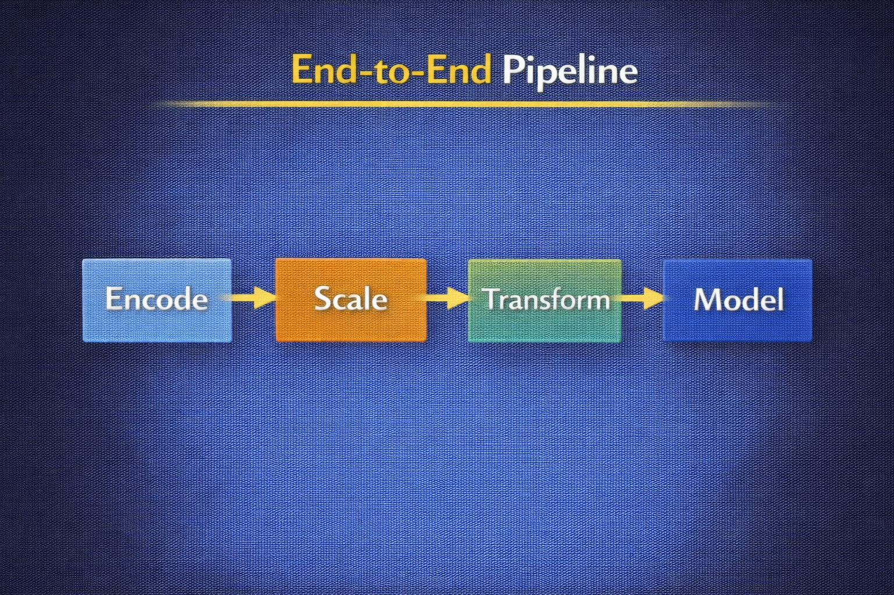
DAY 20 · INTEGRATED EXERCISE
Building the Full Pipeline
Combine all techniques with ColumnTransformer
Pipeline Components
Categorical: encode (OneHotEncoder)
Numeric: scale (StandardScaler)
Binned features
Transformed features
Integrations
sklearn PIPELINE WITH ColumnTransformer
from sklearn.compose import ColumnTransformer
from sklearn.preprocessing import OneHotEncoder, StandardScaler
from sklearn.pipeline import Pipeline
numeric_features = ["pages_viewed", "session_minutes", "basket_value"]
categorical_features = ["city", "device_type"]
numeric_transformer = Pipeline(steps=[("scaler", StandardScaler())])
categorical_transformer = Pipeline(steps=[("ohe", OneHotEncoder(handle_unknown="ignore"))])
preprocess = ColumnTransformer(transformers=[
("num", numeric_transformer, numeric_features),
("cat", categorical_transformer, categorical_features),
])

